Slide 1
Semi Final Results
Zero-sum stochastic game – Light vs. zombies
Eliav shalelashvili

Slide 2
Table of contents
What did we build?
Game Environment
Algorithms
Agents
Game Scenarios
Game Evaluation

Slide 3
Research goal
Build the agent who will excel in the game of light against zombies.

Slide 4
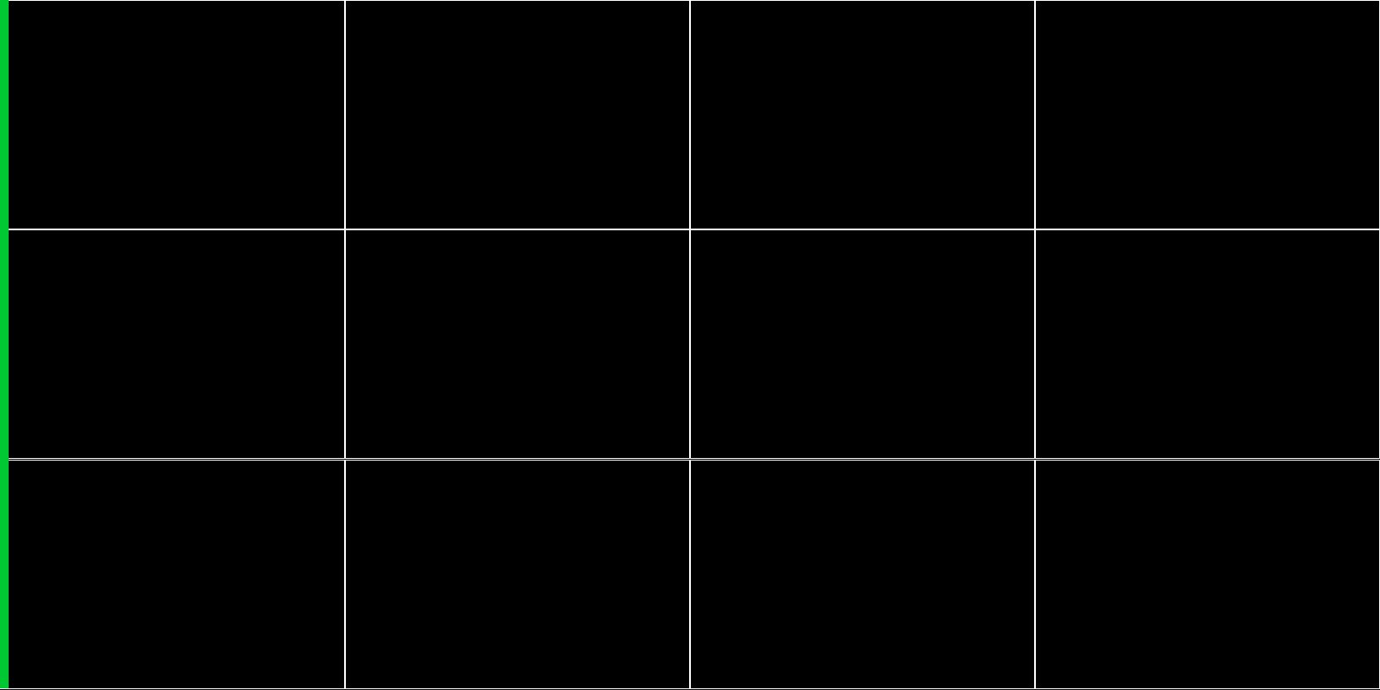
The environment
Reward function
Since we play a two sum game, the reward of the agents is symmetric
The zombie agent receives positive reward of 1 for every zombie that reached the end safely
State space
For the zombie agent, the state consists of zombies positions across the board
The light agent receives the positions as well as the zombies’ strength

Slide 5


Action Space - $N×N$ board
Let us consider a Therefor, the zombie player is able to choose among the $N$start position for a zombie on the left side of the board*
In contrast, the light player can choose any location on the board which adds up to $N×N$ possibilities
Wherever the light is placed, the zombies beneath it absorbs certain amount of damage
For every zombie that reaches the end of the grid, we decide if it will survive based on its current hit points

Slide 6
The code
Building an environment that is able to communicate with an interface of generic type of any agent, turned to be an integrated and significant part of the project:
More than 20 classes and interfaces
Four simple agents
Three algorithms from different domains (Reinforcement Learning and Tree Search)
Before we diving deep into all the gameplay-scenarios, lets review the platform we have built to handle the project demands

Slide 7
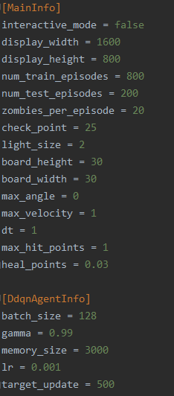
The code
To be able to run the project, we first must define our desired configurations:
The environment: and the learning agent:

Slide 8
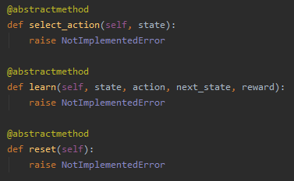
The code
Next, we have to define the minds behind the competitors:
For example, we want to let the Double Deep Q-Learning agent play as the light player against a zombie player that acts according the uniform distribution
Each agent must implement some basic methods in order to participate the game:

Slide 9
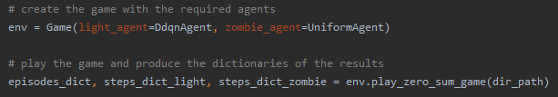
The code
Finally, we are able to run the environment with the agents we have built:
After the scenario ends, we are able to process the results – In a few slides ☺

Slide 10
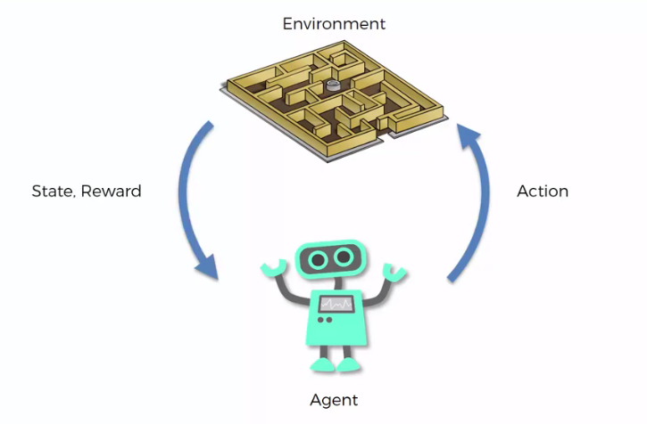


The code - summery
Preparations
1. Define agents and implement by generic interface
2. Add configuration of agents and environment
Main Process
3. Run the game with two agents as light and zombie players
LIGHT
ZOMBIE

Slide 11
video
TODO

Slide 12

Games and agents
Game Boards: $10×10, 20×20, 30×30$
Simple Agents:
Single Action
Double Action
Uniform
Gaussian
Learning Agent:
Double Deep Q-Learning

Slide 13
Simple Agents elaboration
TODO

Slide 14
Double deep q-learning evaluation
To estimate the success of a learning DDQN agent, we will use average test score.
Since we are using epsilon greedy strategy, the known ‘Time to Convergence’ indicator is redundant
Later on, we are going to choose the best sets of parameters and look at the action distributions of the players in the chosen games
At last, we are going to compare the results of the best agent over the different competitors

Slide 15
Game config
Fixed Parameters:
Number of training episodes: 800
Number of test episodes: 200
Zombies per episode: 20
Light size: 2*
Minimum hit points of certain death: 1
Heal ratio: 0.97
Tuning Parameters:
Target Policy update frequency – [500, 750, 1000]
Replay Memory size – [3000, 4000, 5000]

Slide 16
game scenarios
Zombie Player | Light Player | Game Board
Single Action | DDQN | 10x10
Double Action
Uniform
Gaussian
Single Action | DDQN | 20x20
Double Action
Uniform
Gaussian
Single Action | DDQN | 30x30
Double Action
Uniform
Gaussian
Zombie Player | Light Player | Game Board
DDQN | Single Action | 10x10
 | Double Action
 | Uniform
 | Gaussian
DDQN | Single Action | 20x20
 | Double Action
 | Uniform
 | Gaussian
DDQN | Single Action | 30x30
 | Double Action
 | Uniform
 | Gaussian

Slide 17
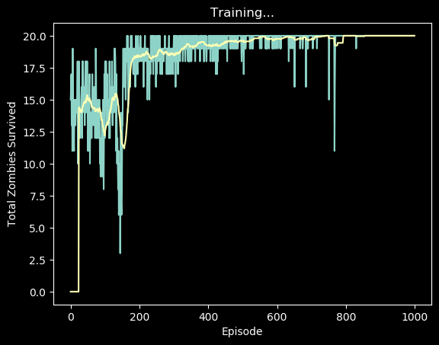
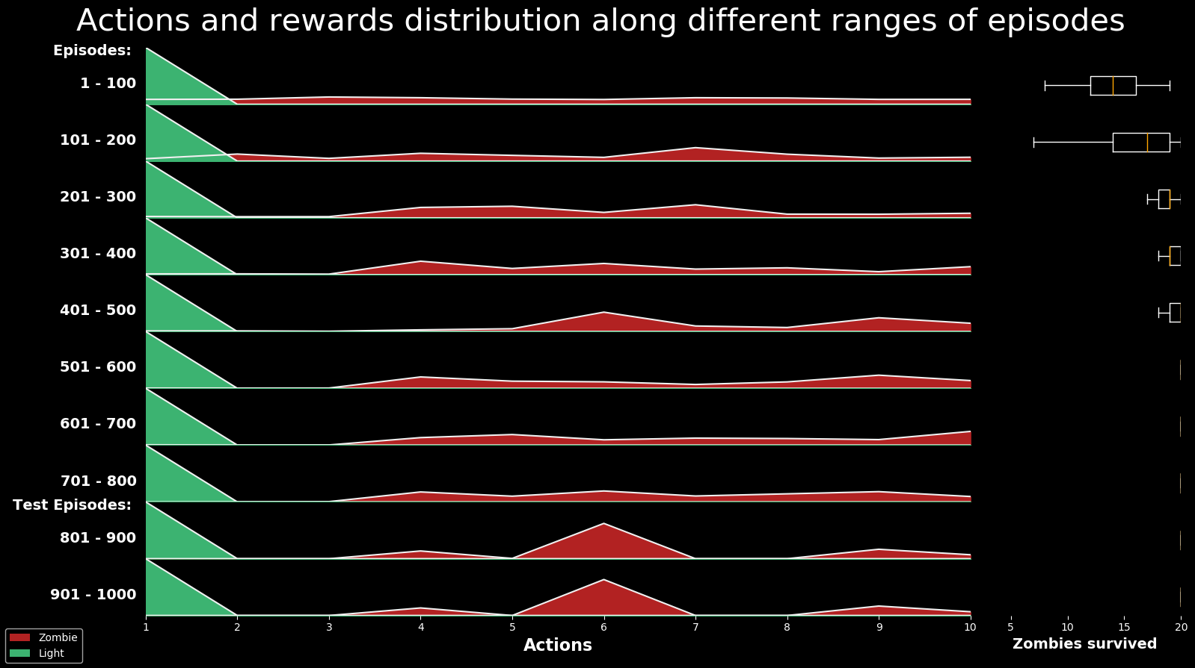
Example of a single evaluation
For each scenario (for example, DDQN as Zombie and Single Action Agent as Light), we produces two types of results - Rewards and Action Distribution:

Slide 18

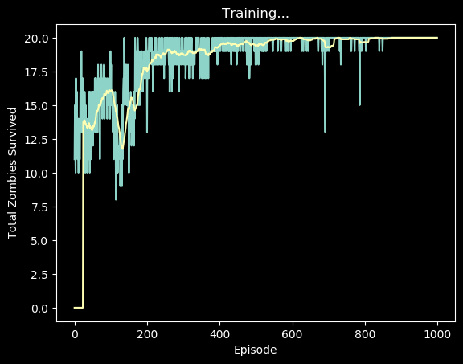



Example of a single evaluation
Considering the scenario of DDQN as Zombie and Single Action Agent as Light on top a board of $10×10$:
First, repeat the scenario several times
Second, get the average of test rewards
Average
$$−>$$
19.99

Slide 19
DDQN as the zombie player
Goal – Maximize Total Reward

Slide 20
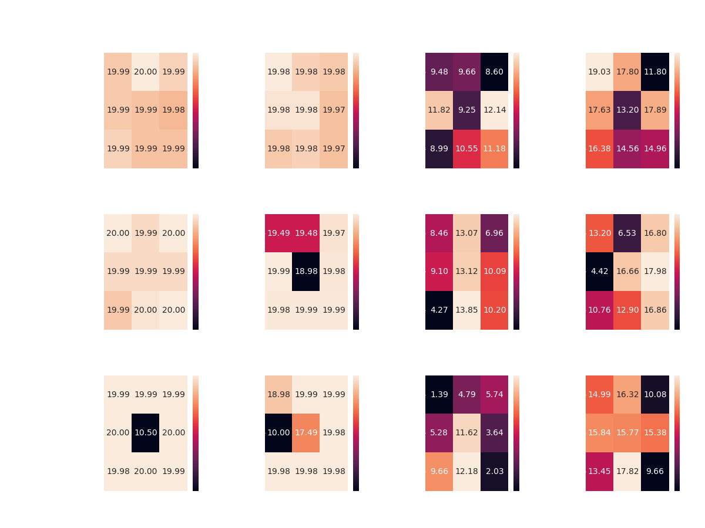
DDQN agent vs. Single Action agent
Board of 10x10
Goal: Maximize Total Reward (Minimum zombies survival)

Slide 21
DDQN vs. all Simple Agents – board of 10x10

Slide 22
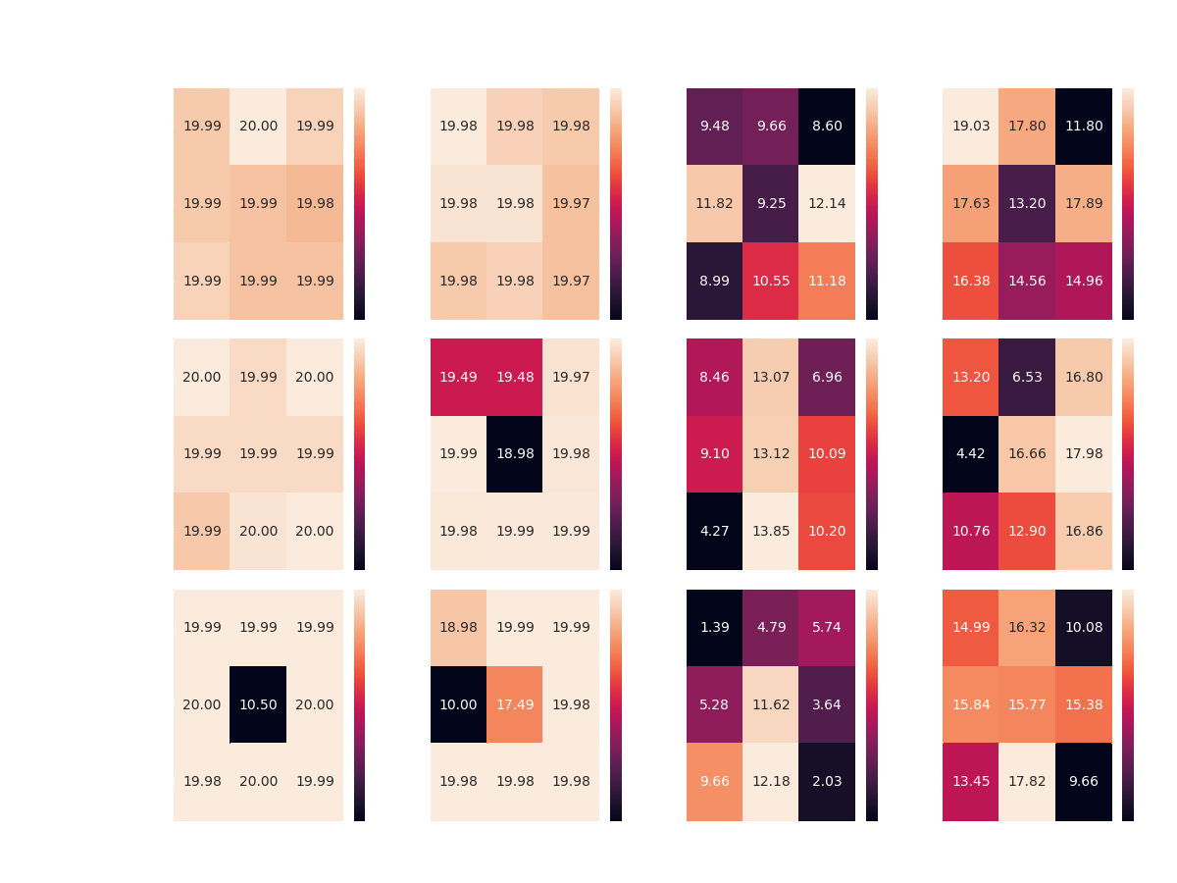

Slide 23
Results Discussion
Overall, it seems that the DDQN agent manages to overcome its competitors in most of the scenarios:
Achieving optimal reward competing Single and Double Action Agents with most of the configurations, on top all boards
Achieving 17+ average reward competing the Gaussian Agent on all boards, without achieving optimal reward in any scenario
However, the DDQN agent seems to encounter difficulties when faced with the Uniform Agent – managing to achieve average reward of 12-14

Slide 24
Results Discussion
While Competing against both the Random Agents, the DDQN Agent gets approximately same average reward over all three boards
Perhaps more learning episodes would make a change here?
Keep in mind that the highest reward against the Uniform Agent as light player is 15 – calculated by an agent which picks the best action exclusively (places zombies at the first row)
To settle the issue, I ran multiple scenarios of the same configuration, DDQN Agent vs. Uniform Agent, this time with 1800 learning episodes and 200 test episodes – all cases yield to the same average test reward of around 12

Slide 25
DDQN plays zombie - Best configurations*
Board size | Competitor | Memory Size | Target Update | Average Test Reward
10x10 | Single Action | 20 | 750 | 3000
 | Double Action | 19.98 | 500 | 3000
 | Uniform | 12.14 | 1000 | 4000
 | Gaussian | 19.03 | 500 | 3000
20x20 | Single Action | 20 | 500 | 3000
 | Double Action | 19.99 | 500 | 4000
 | Uniform | 13.85 | 750 | 5000
 | Gaussian | 17.98 | 1000 | 4000
30x30 | Single Action | 20 | 750 | 5000
 | Double Action | 19.99 | 1000 | 3000
 | Uniform | 12.18 | 750 | 5000
 | Gaussian | 17.82 | 750 | 5000

Slide 26
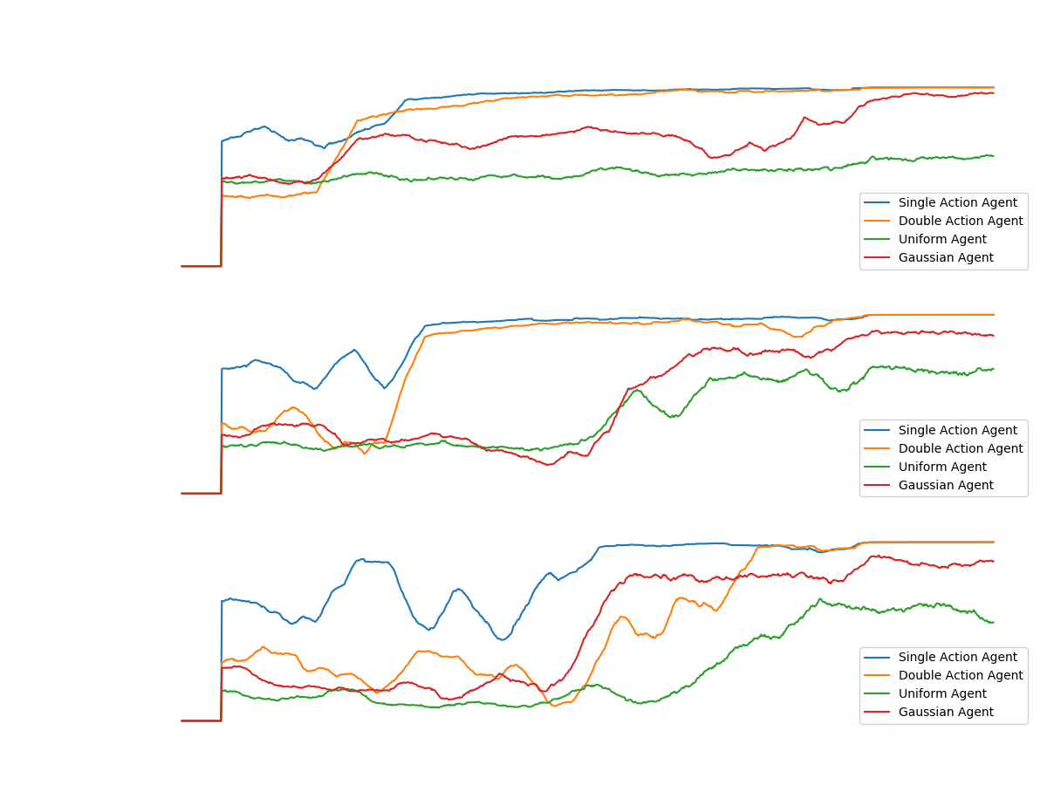
Notes:
נשים לב שבמקרה שבו האלגוריתם משחק את הזומבי, התגמול חיובי

Slide 27
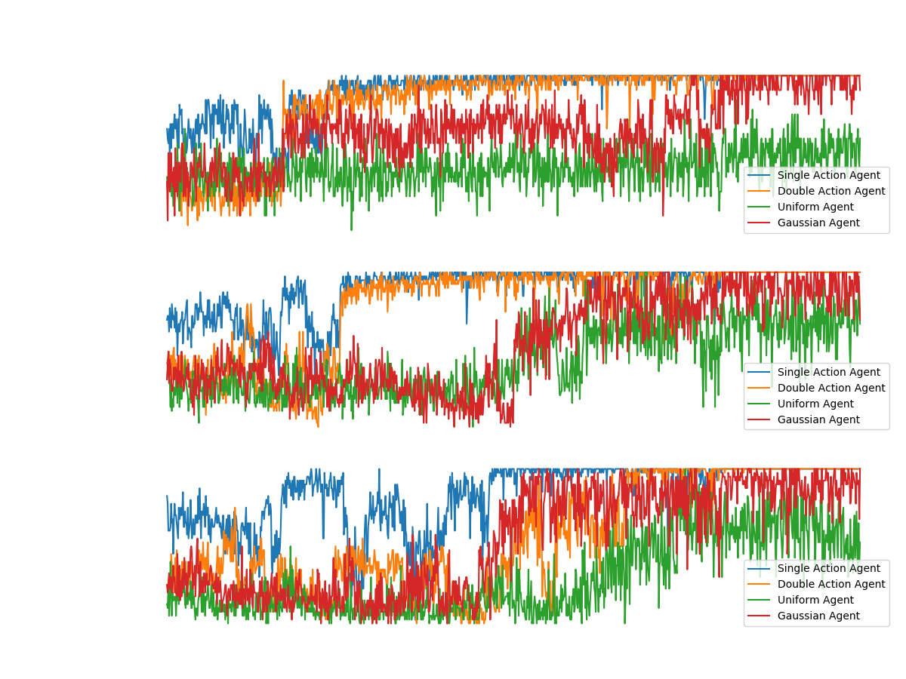

Slide 28
DDQN as the light player
Goal – Maximize Total Reward – Minimize Zombies survive

Slide 29
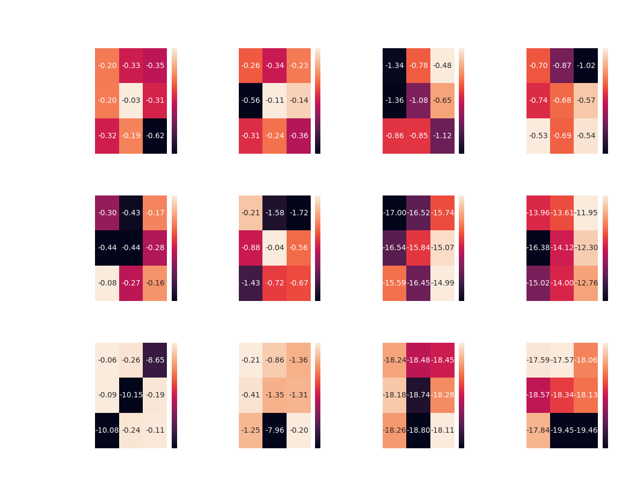
DDQN agent vs. Single action agent
Board of 10x10
Goal: Maximize Total Reward (Minimum zombies survival)
Get negative rewards as the opposite of Zombie Player
Notes:
We keep showing the rewards of the zombie player – the goal of the light is to minimize it.

Slide 30
DDQN vs. all – board of 10x10

Slide 31
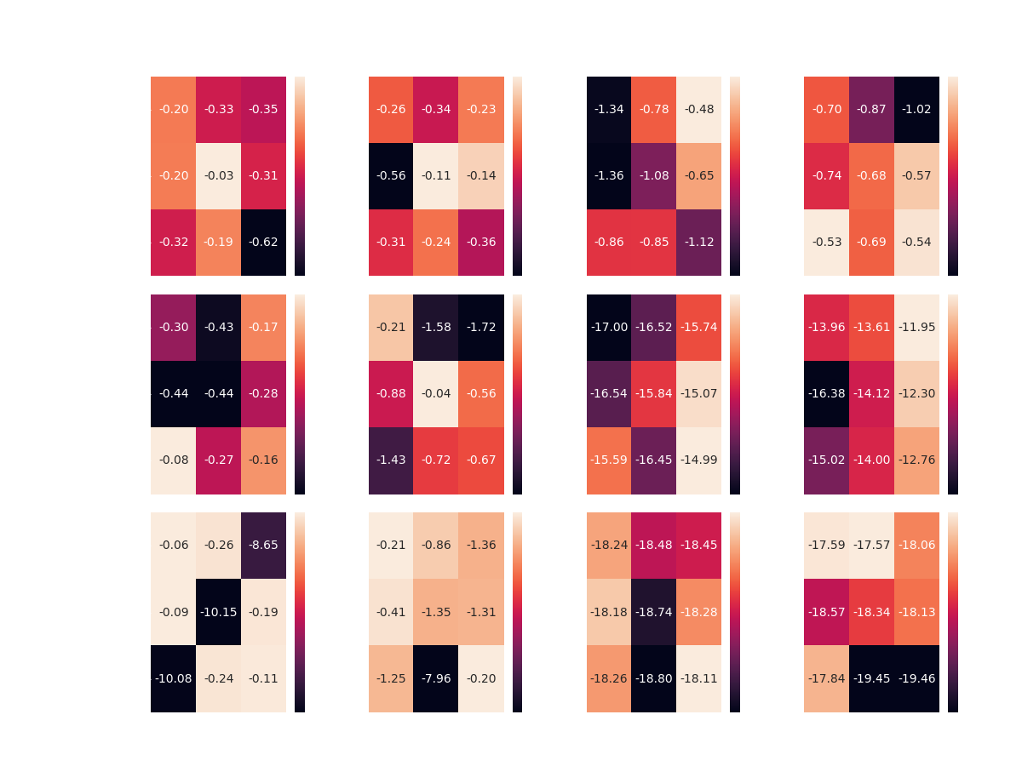

Slide 32
Results Discussion
This time the DDQN Agent managed to achieve partial success.
Over all boards, the DDQN Agent seems to overcome the two Constant Agents
With some preference of the [750, 4000] configuration in half of the cases
However, competing the Random Agents didn’t lead to same success
The DDQN Agent was able to reach optimality only in the case of the smallest board
This time, without any preference of any specific configuration

Slide 33
DDQN plays light - Best configurations
 | Competitor | Memory size | Target update | Average Test Reward
Board 10x10 | Single Action | 4000 | 750 | 0.03-
 | Double Action | 4000 | 750 | 0.11-
 | Uniform | 3000 | 1000 | 0.48-
 | Gaussian | 5000 | 500 | 0.53-
Board 20x20 | Single Action | 5000 | 500 | 0.08-
 | Double Action | 4000 | 750 | 0.04-
 | Uniform | 5000 | 1000 | 14.99-
 | Gaussian | 3000 | 1000 | 11.94-
Board 30x30 | Single Action | 3000 | 500 | 0.06-
 | Double Action | 5000 | 1000 | 0.2-
 | Uniform | 5000 | 1000 | 18.11-
 | Gaussian | 3000 | 750 | 17.57-

Slide 34
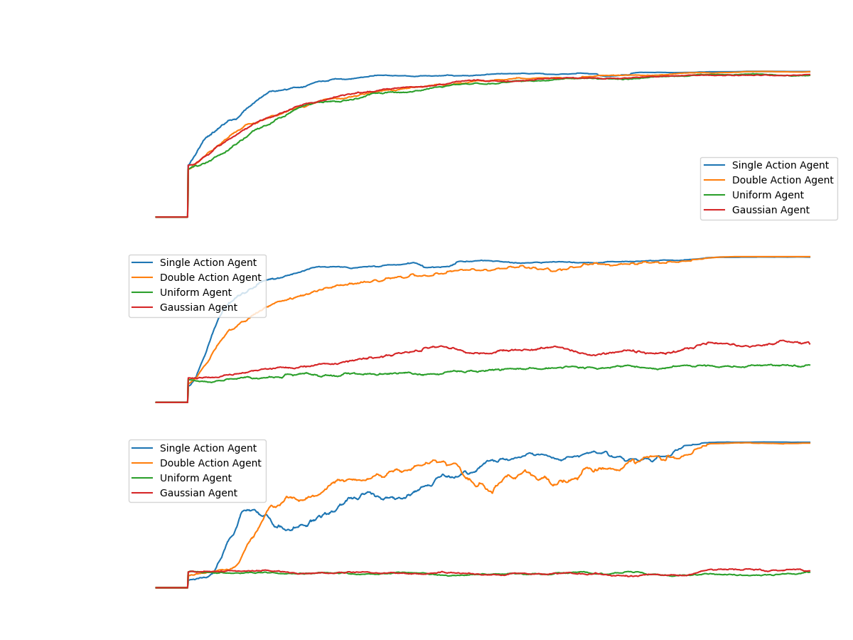
Notes:
נשים לב שבמקרה שבו האלגוריתם משחק את האור, התגמול חיובי

Slide 35
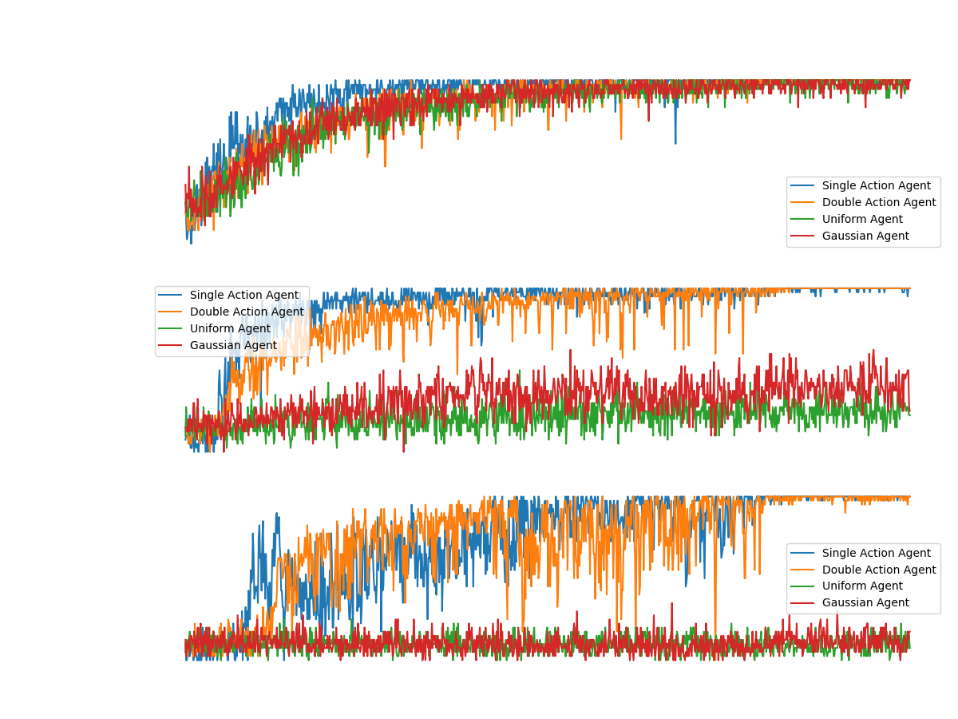

Slide 36
Do-do’s
Further elaboration on all simple agents
Ask Yehudit:
Add a slide to scenarios and elaborate on the tuning params? (Target policy update frequency and replay memory size)
Add action distribution graphs of best agents? (12 graphs for each player type)
What should we do with almost final convergence and non converge at all? Should we try to rerun with more episodes?

